Slide 1
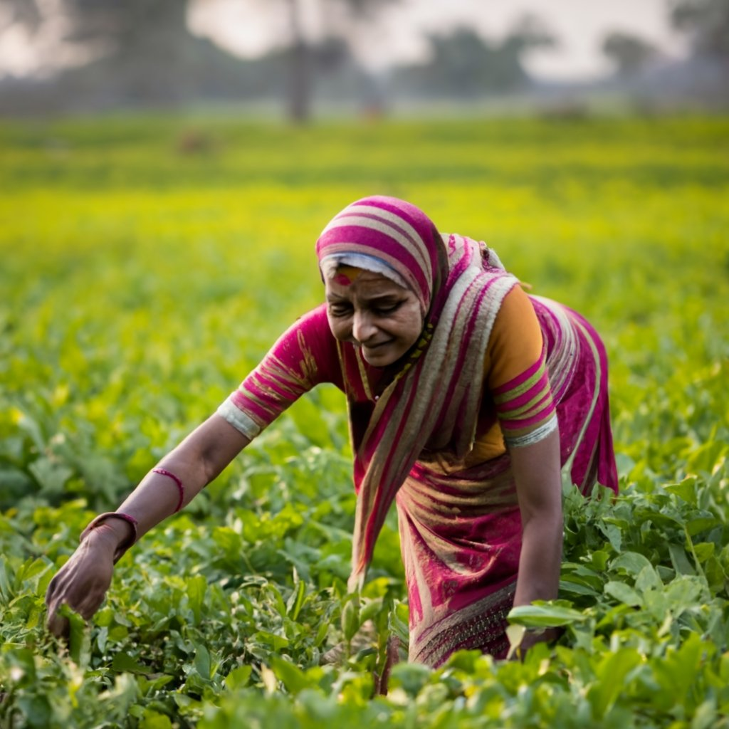
Indian Agriculture Crop Production Analysis
Let’s get started

Slide 2
A process step by step
Step 01
Step 02
Step 03
Step 04
Step 05
Step 06
Introduction
Data Cleaning
Visualization
Correlation
Model Comparison
Project Report

Slide 3

Introduction
The main goal of this research project is to examine the data, on crop production in districts of India from 1997 to 2021. The key person involved in this project is the Minister of Agriculture and Farmers Welfare in India, who plays a role, in creating policies and making important choices that affect the lives of countless farmers throughout the nation.

Slide 4
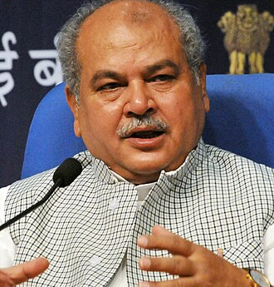
Stakeholder
Narendra Singh Tomar is a prominent Indian politician. He served as the Union Minister of Agriculture and Farmers Welfare, overseeing agricultural policies and reforms in India. His tenure included controversial agricultural reforms, and he has held various other key ministerial positions in the Indian government over the years. On 18th September 2020, Tomar was assigned the additional charge of the Ministry of Food Processing Industries.

Slide 5

01 Data Cleaning
Removed empty values in the Crop and Area Column
Removed null values in the Yield Column
Far we've made sure to eliminate any data, in the dataset to improve accuracy. Lastly we decided to remove the Area Units column since it only had one value, which happened to be 'Hector'.

Slide 6

02 Data Visualization

Slide 7
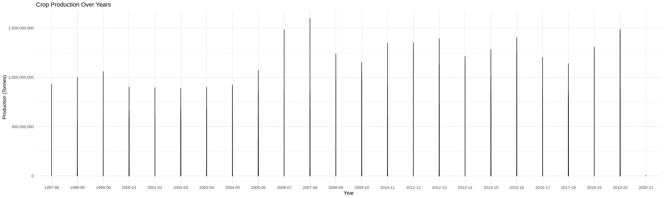
i) Crop Production Over Years
As we can see, in the year 2007-08, production was at its highest, reaching around 1,500,000,000.

Slide 8
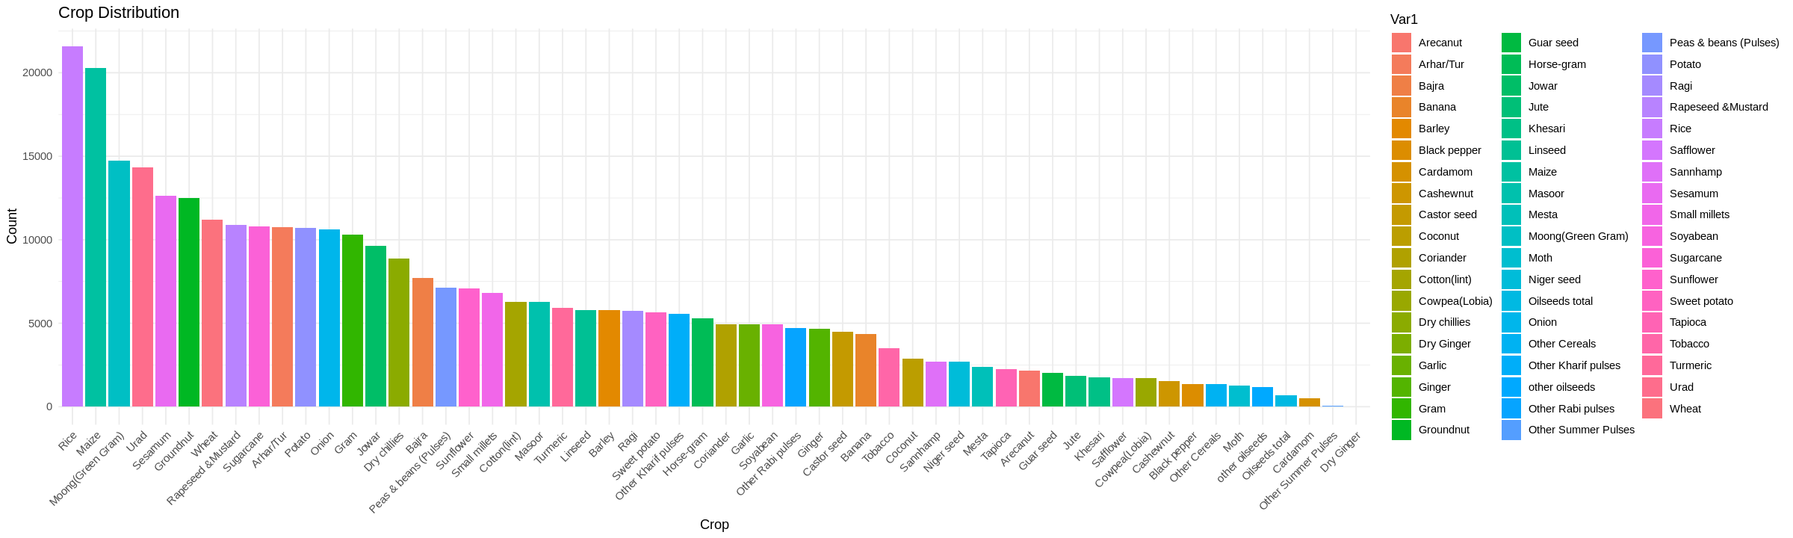
ii) Crop Distribution
It shows that the counts of crops vary widely, with a minimum of 3 and a maximum of 21,567, and the average count is around 5,651.21. That indicates the degree of variability in the counts.

Slide 9
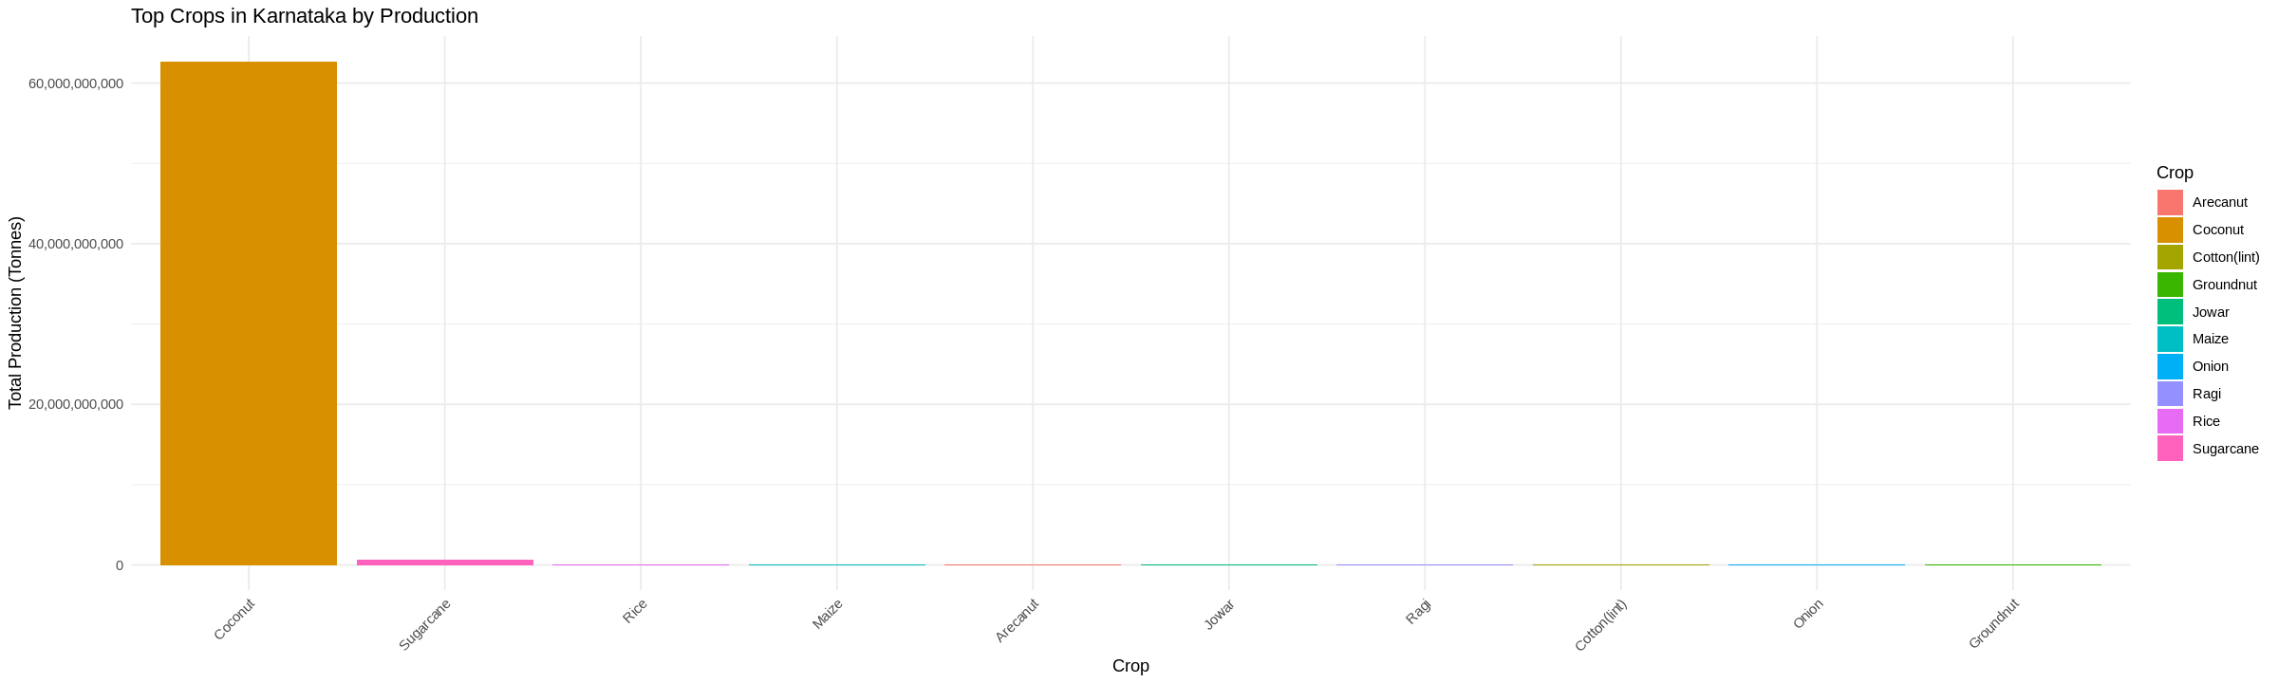
iii) Top Crops in Karnataka by Production
With a production of 62,692,166,000 tones, coconut outperforms all other crops in the dataset, while groundnut has the lowest production at 13,305,874 tones

Slide 10
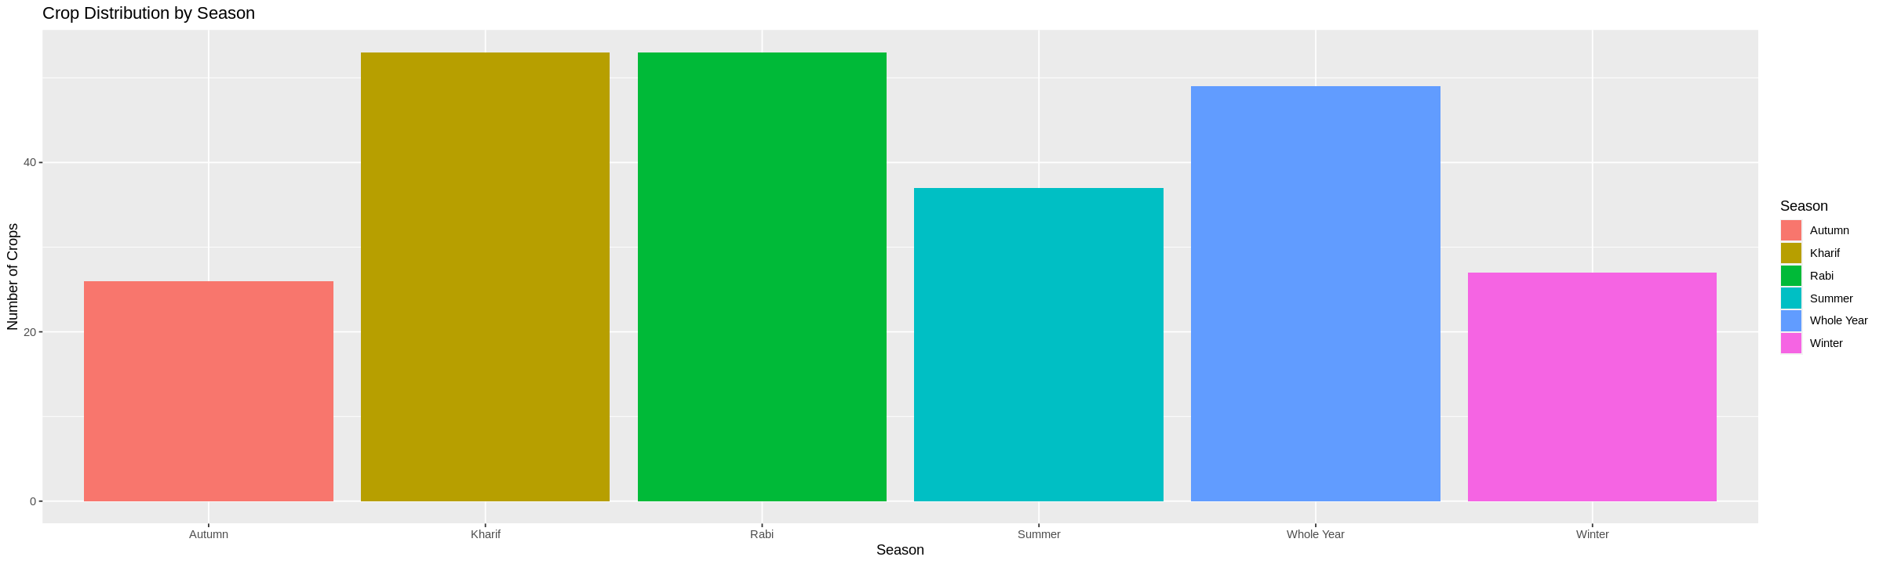
iv) Seasonal Focus
The 'Kharif' & 'Rabi' season is when the majority of crops are grown. To increase agricultural output, stakeholders should think about concentrating their efforts and investments on this season.

Slide 11

03 Correlations
There is a moderate positive correlation (0.437) between Yield (crop output) and Production (total output), suggesting that as crop yield increases, total production tends to increase as well.

Slide 12
Total production by Crop
Crop | Production(billion)
Coconut | 31B
Sugarcane | 7B
Rice | 2B
Wheat | 2B
Potato | 63M
This indicates that the southern region plays a role, in the countries productivity. Because, Kerala and Tamil Nadu have a presence in Indians production sector making a contribution to the overall output.

Slide 13
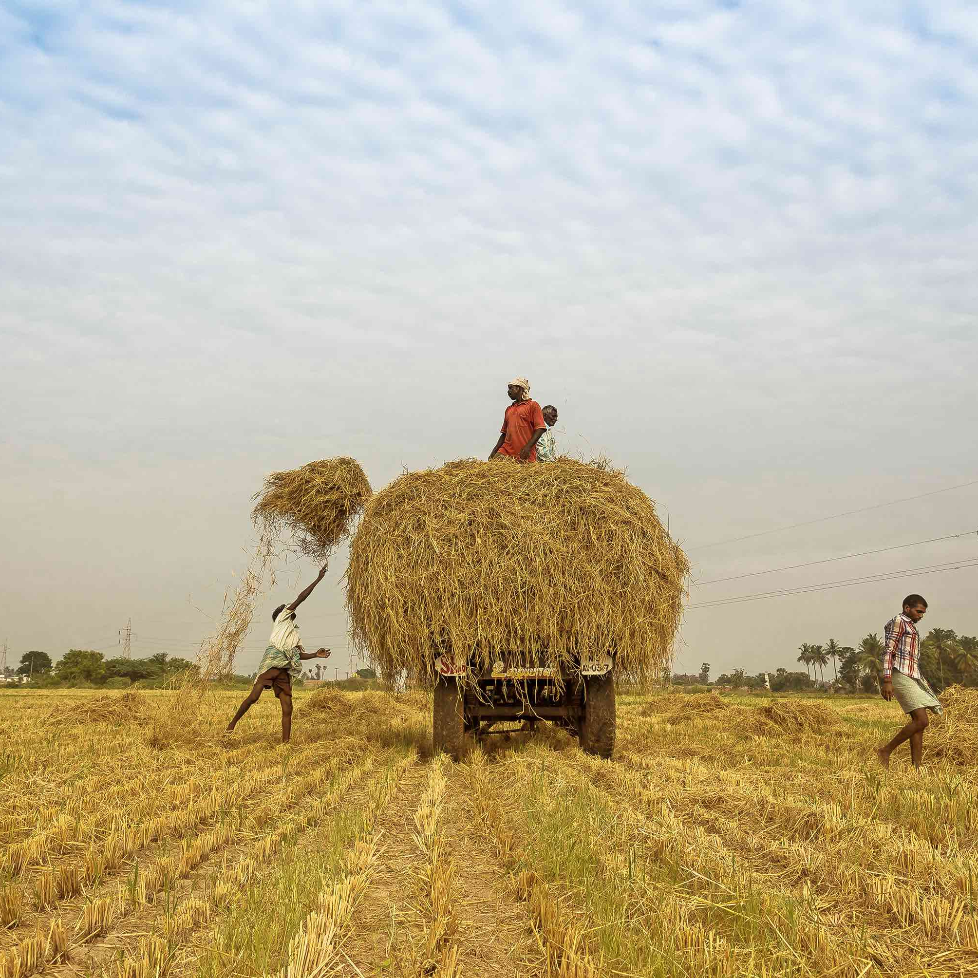
04 Simple Linear Regression Model
Model 1: Production vs Yield (R2: 94%)
Model 2: Total Area Hectares vs Avg Yield per Hectare
(R2:45%)
Model 3: Yield vs Area (R2: 36%)
Model 4: Yield vs Avg Yield per Hectare (R2: 27%)
Model 5: Total Production Tones vs Yield (R2: 24%)

Slide 14
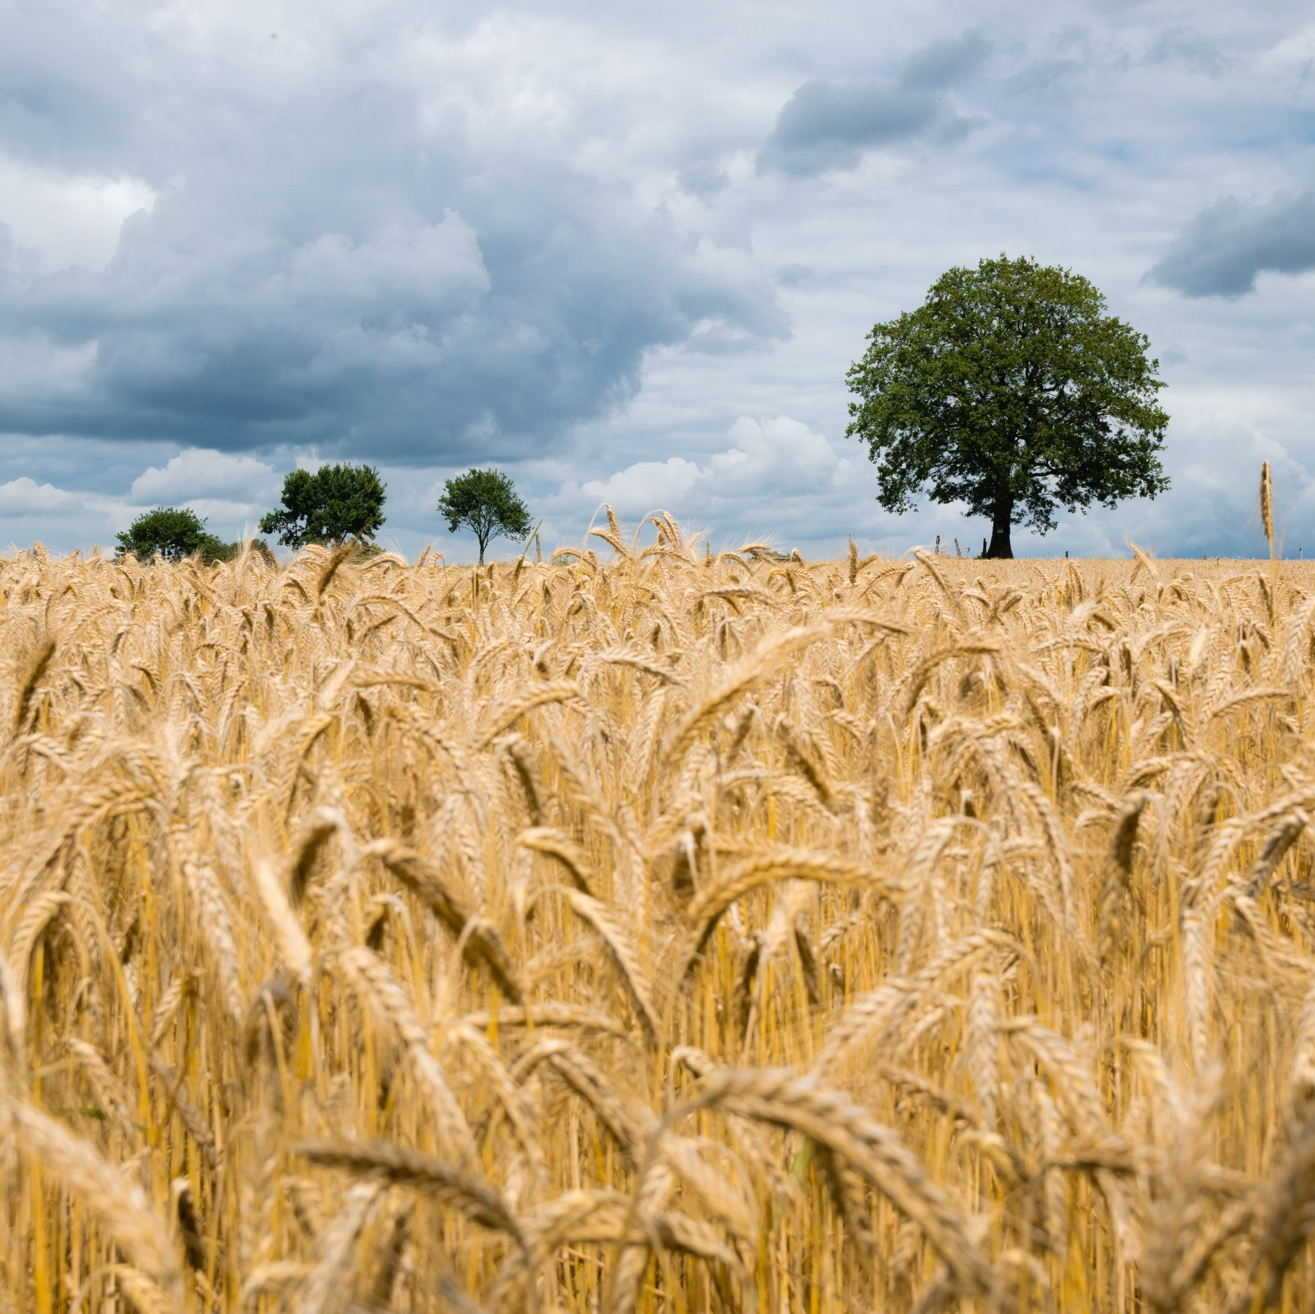
05 Multiple Linear Regression Model
Model 1 : Yield vs Production Area (R2: 19.55%)
Model 2 : Yield ~ Production + Area + Yield per Hectare (R2: 25.13%)
Considering these factors, Model 2 appears to be slightly better than Model 1 based on the higher R-squared and adjusted R-squared values, indicating that it explains a bit more of the variability in the data. However, it's important to keep in mind that the choice between these two models may also depend on the specific context and goals of your analysis, as well as domain knowledge.

Slide 15
06) Model Comparison
45%
25%
Simple Linear Regression
Multiple Linear Regression
Total Area Hectares ~ Avg Yield per Hectare
Yield ~ Production + Area + Yield per Hectare
R²: 0.454662
F-statistic: 1117
R²: 0.251
F-statistic: 3.025
We would recommend choosing Model 1 over the option because it has a level of predictive accuracy and a lower Residual Standard Error (RSE). Additionally Model 1 remains statistically significant with a adjusted R squared and F statistic. As a result it can offer forecasts and provide better insights that can aid in making informed decisions.

Slide 16
Summary of findings
Seasonal Focus: The 'Kharif' & 'Rabi' season is were majority of crops are grown. To increase agricultural output, stakeholders should think about concentrating their efforts and investments on this season.
Coconut Dominance: With an astounding 310.8 billion units produced, coconuts take the top spot among all crops. This demonstrates how crucial coconut cultivation is to India's agricultural sector.
Regional Influence: The analysis emphasis the importance of India's southern area, with states like Tamil Nadu and Kerala making sizable contributions to the nation's total crop production. For stakeholders, understanding regional dynamics is essential.
Production Peak: In the year 2007-08, India experienced its highest agricultural production, reaching approximately 1.5 billion units. This year marked a significant milestone in the country's agricultural sector

Slide 17
Recommendations
Fruit investment: Given the widespread use of fruit production, stakeholders are urged to look into investment possibilities in this industry. Fruits continue to have a strong market demand, making this a profitable business.
Area Strategies: Take into account adjusting your plans to account for area differences. Due to its significant contribution, the southern region merits special consideration and possible cooperation with nearby farms.
Crop Diversification: Coconut is the most popular Crop, however diversifying crop portfolios might reduce risks brought on by relying too heavily on a single crop. It is important to investigate crop diversity and rotation options.
Seasonal Planning: Time agricultural investments and operations to coincide with the "Kharif" season, when crop cultivation is at its peak. Planning ahead and allocating resources efficiently helps maximize yield.
Continuous Monitoring: Use data-driven decision-making processes and routine monitoring to adjust to shifting market dynamics and agricultural trends.

Slide 18

Thank You
JENISH ALKESHKUMAR VEKARIYA

